Slide 1
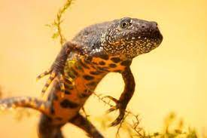
Survival of the great crested newt (Triturus cristatus) under different management strategies

Slide 2
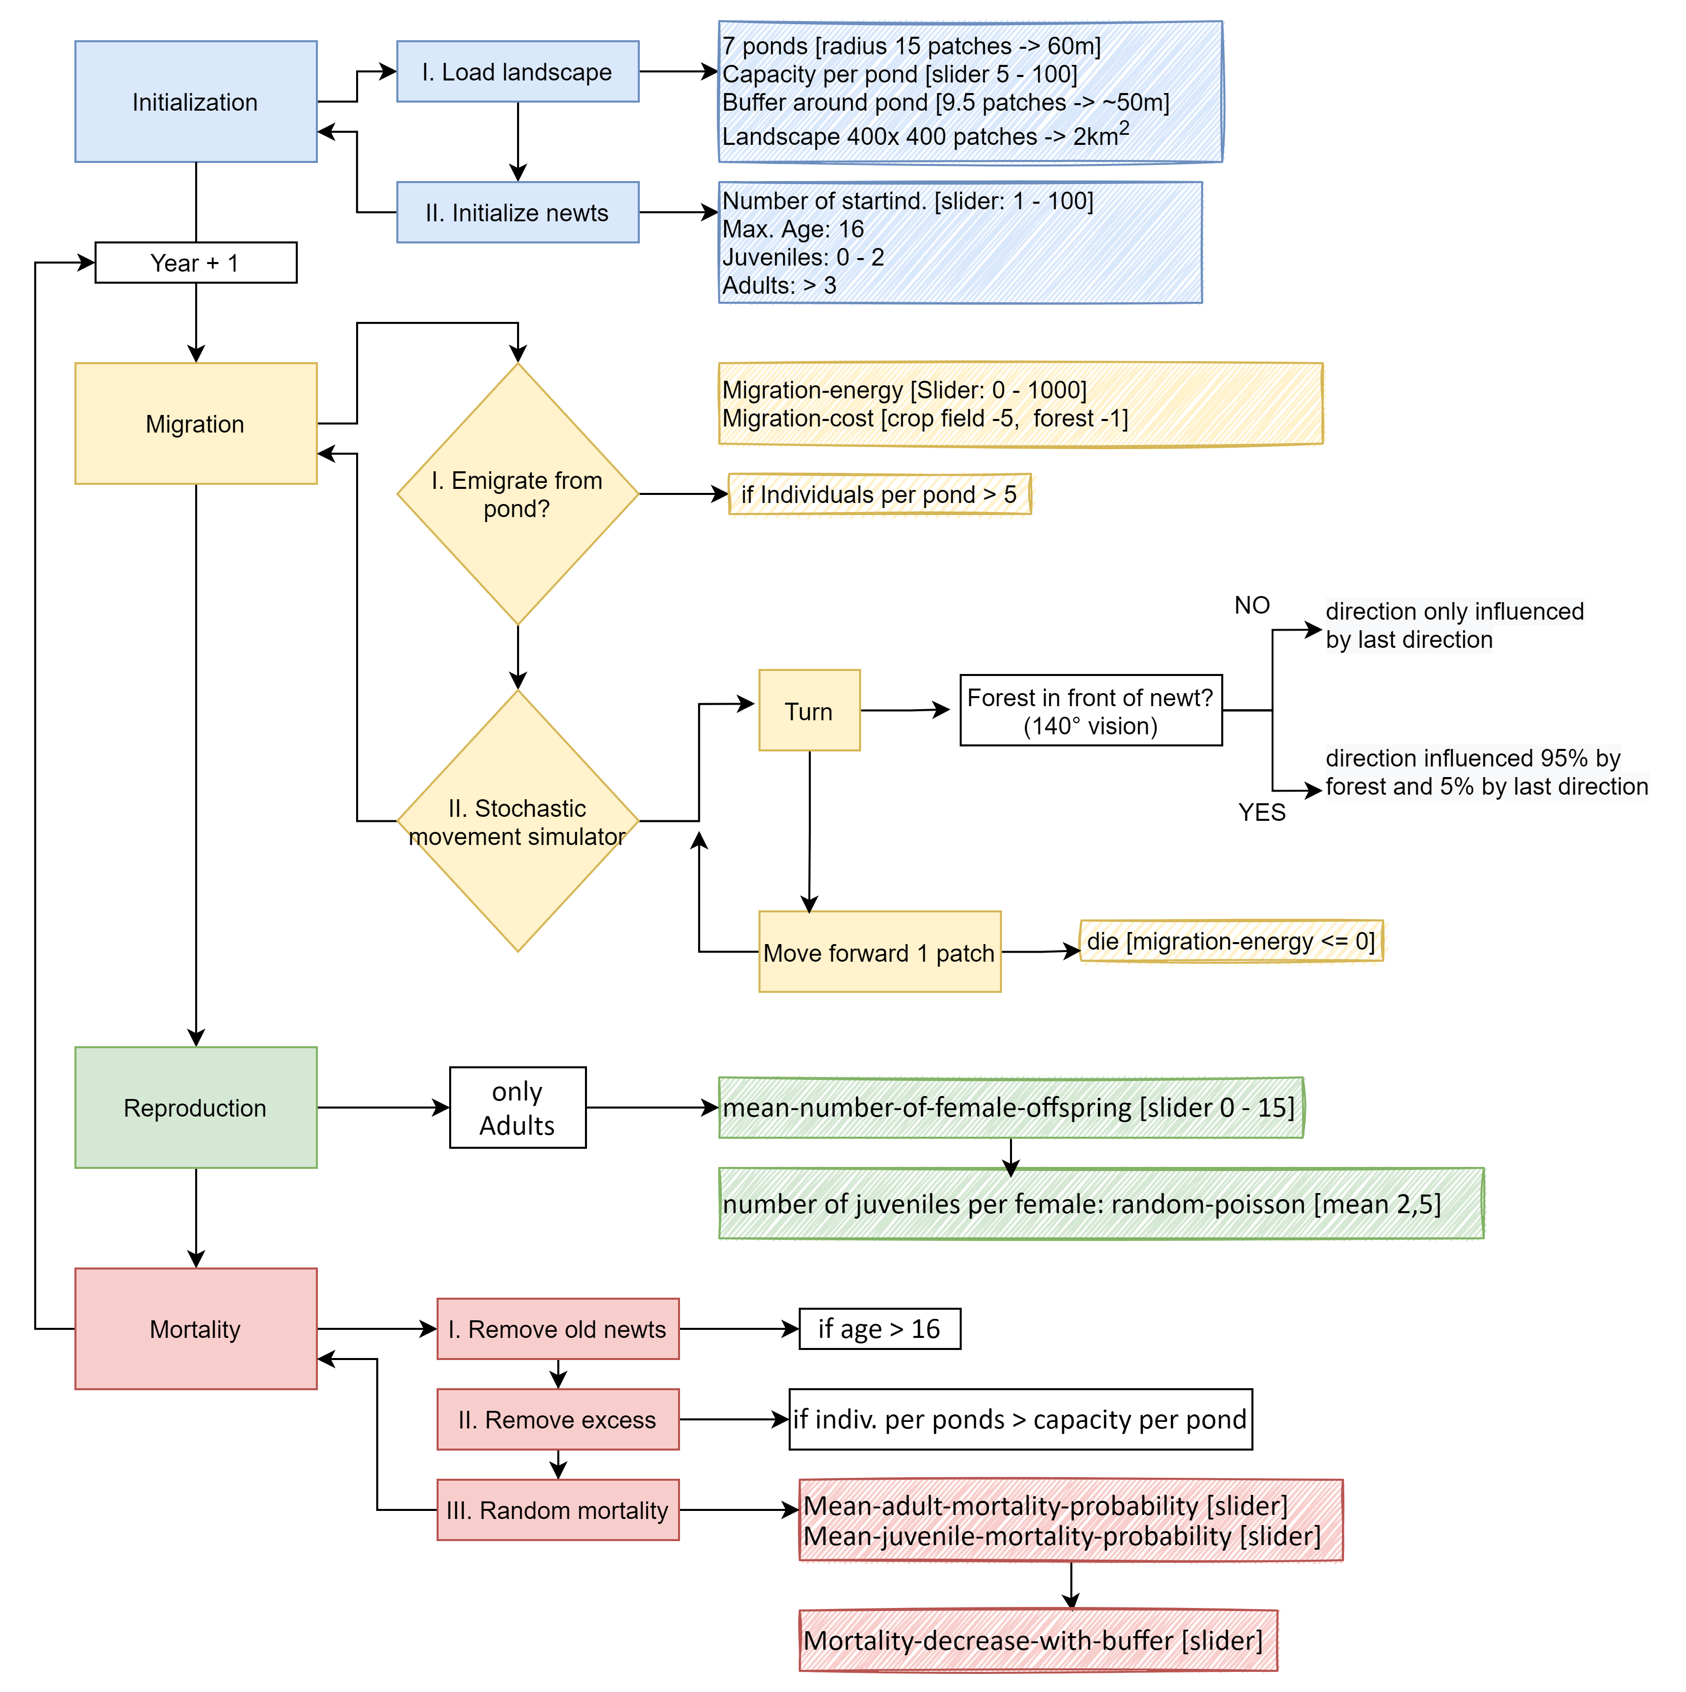

Slide 3
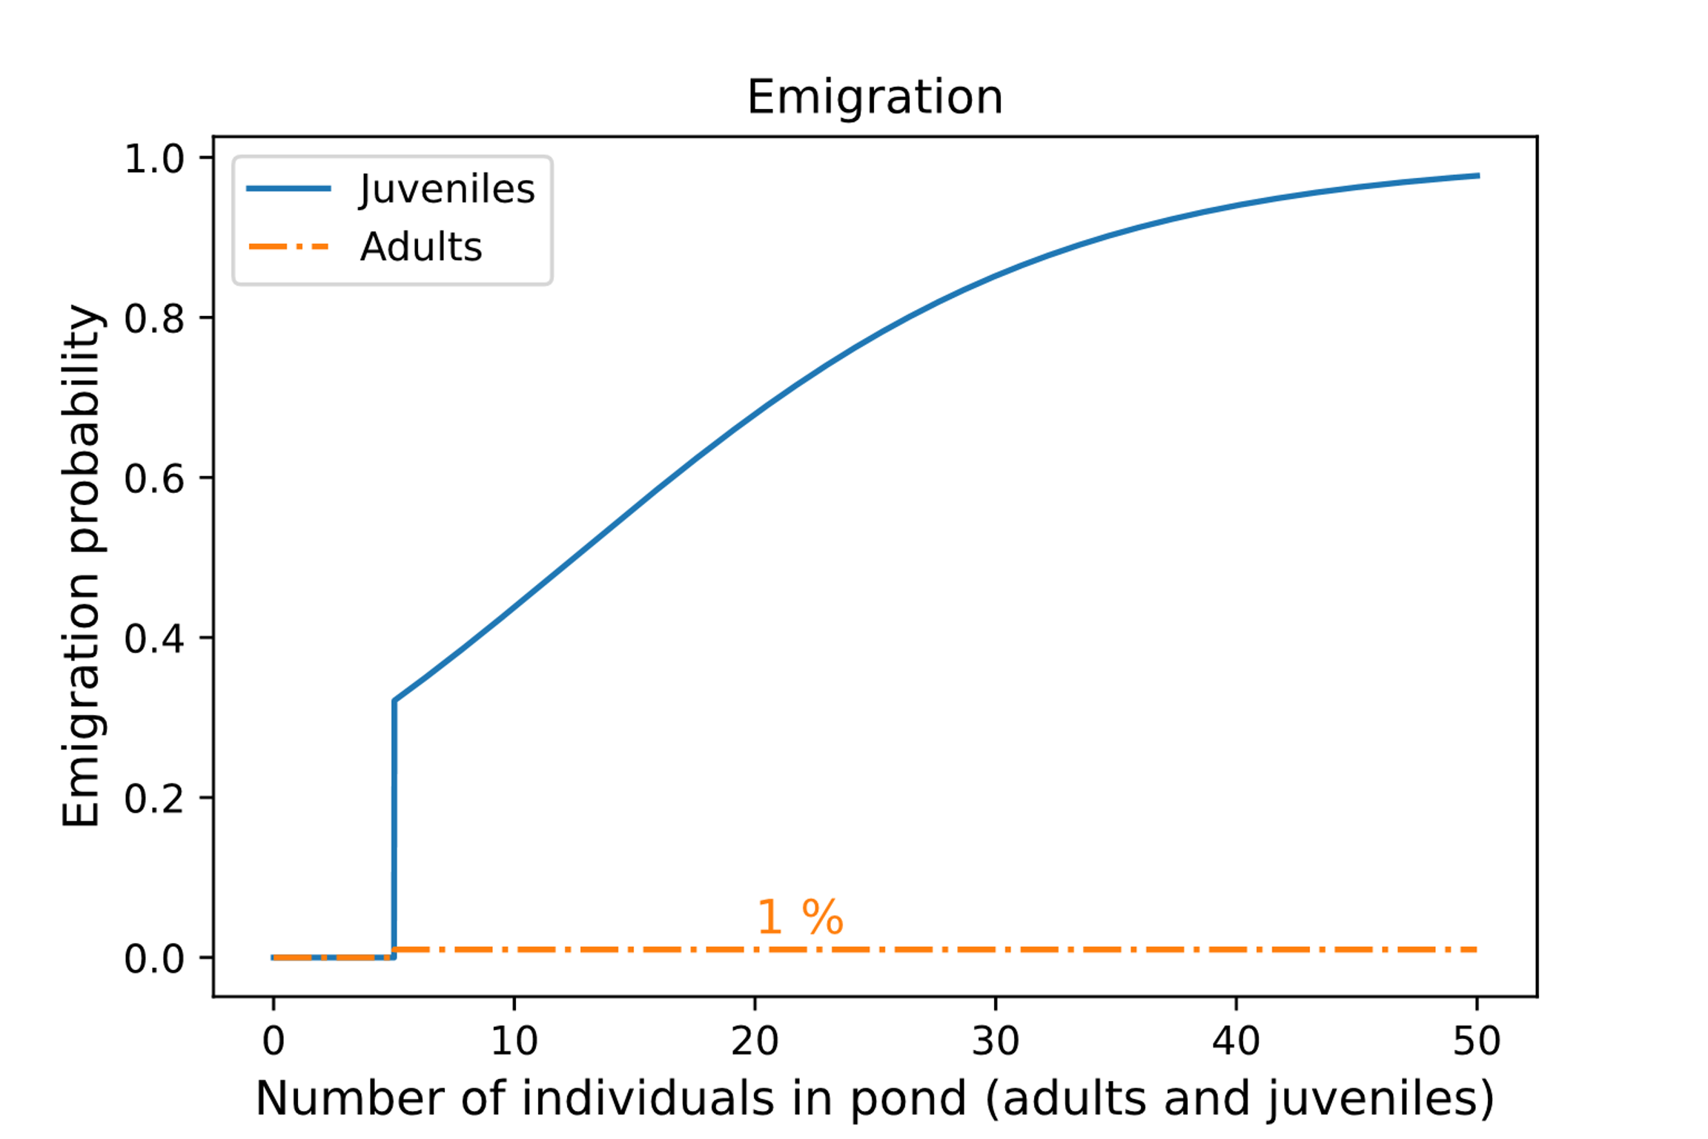
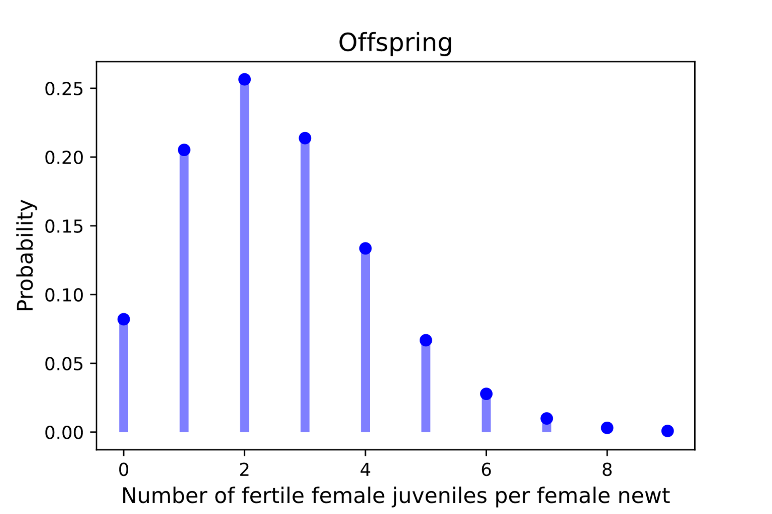
Rules

Slide 4


Habitats

Slide 5
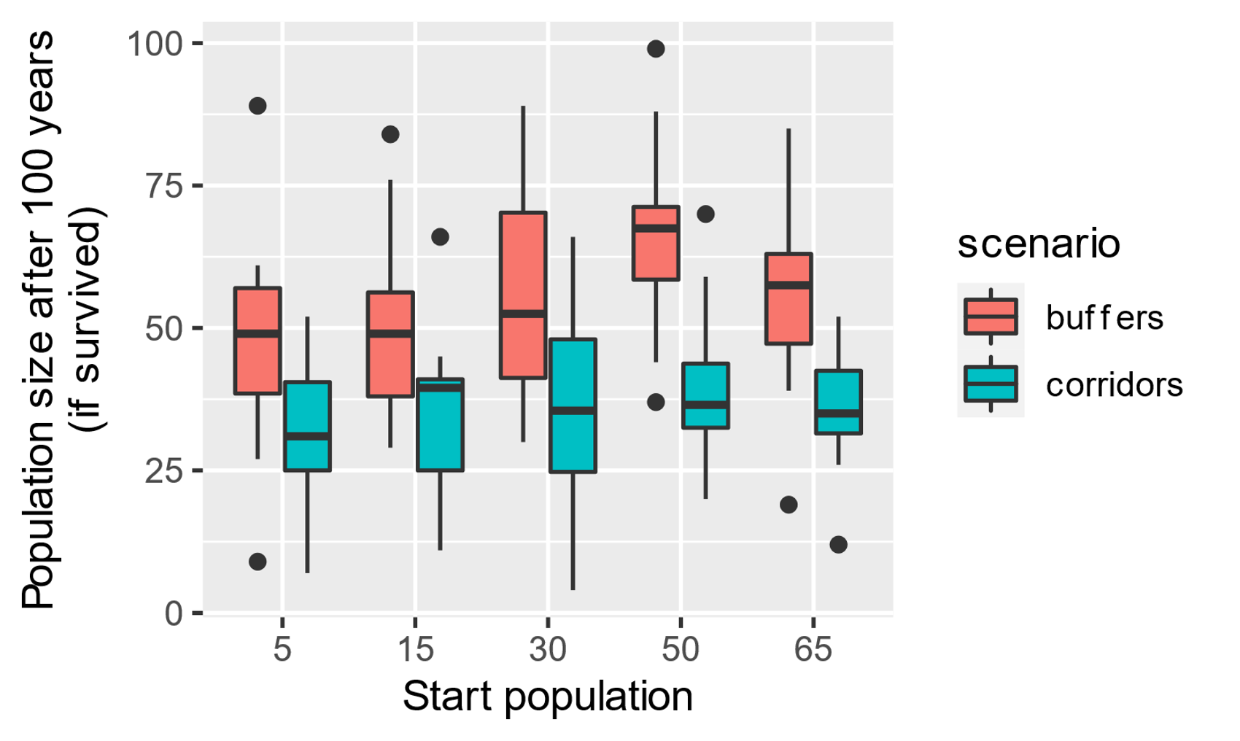

Slide 6
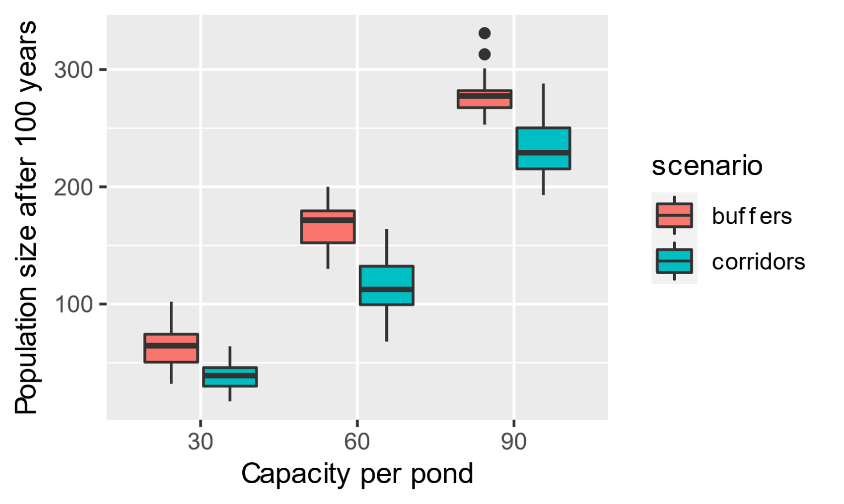

Slide 7
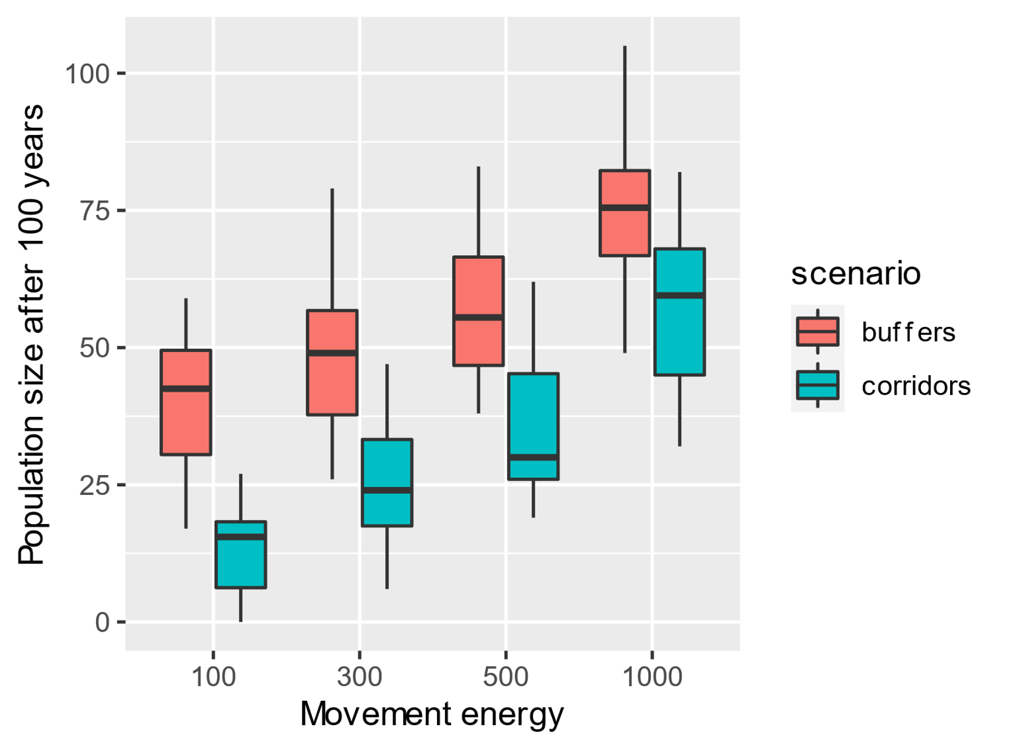

Slide 8
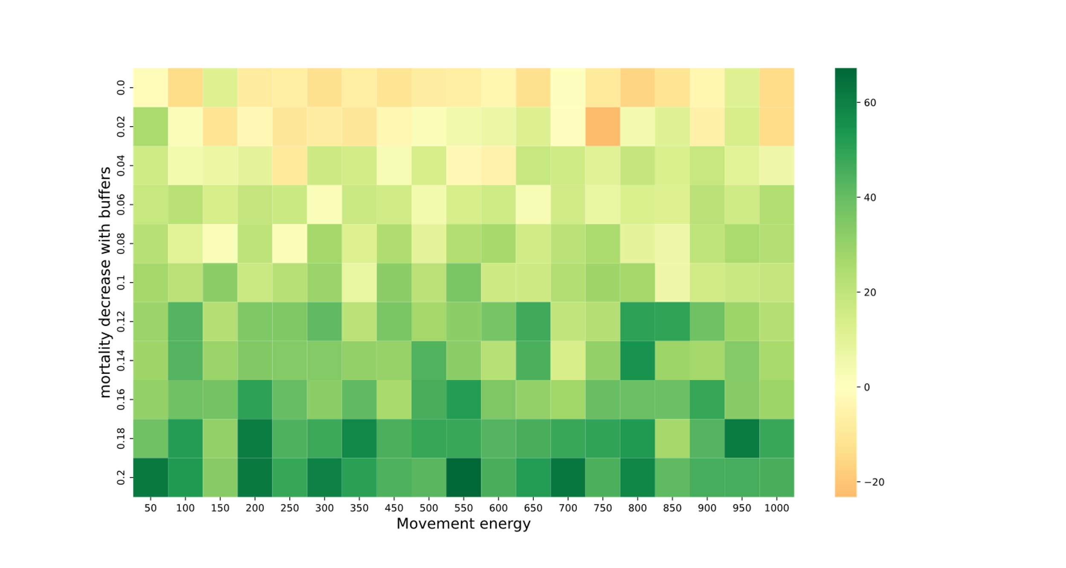

Slide 9
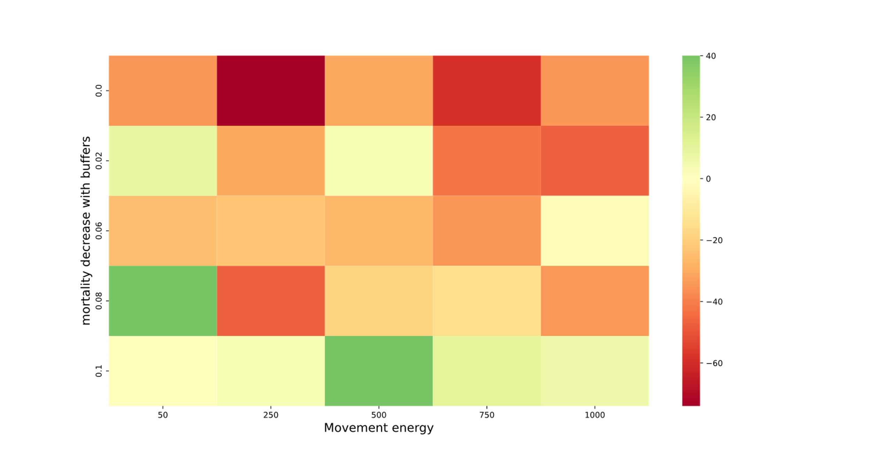

Slide 10
References
https://www.acerecology.co.uk/great-crested-newt-year/ (24.09.21)
Arntzen, Jan; Teunis, S. (1993): A six year study on the population dynamics of the crested newt Triturus cristatus following the colonization of a newly created pond. In: Herpetological Journal 3, S. 99–110.
Baker, John M. R. (1999): Abundance and survival rates of great crested newts (Triturus cristatus) at a pond in central England monitoring individuals. In: Herpetological Journal 9, S. 1–8.
Cummins, Clive P.; Swan, Mary J. S. (2000): Long term survival and growth of free living great crested newts (Triturus cristatus) PIT-tagged at metamorphosis. In: Herpetological Journal 10, S. 177–182.
Griffiths, Richard A. (2004): Great crested newts in Europe: the effects of metapopulation structure and juvenile dispersal on population persistence. In: Jeffrey Hatfield und M. Mccarthy (Hg.): Species conservation and management : case studies. New York: Oxford University Press, S. 281–291.
Hatfield, Jeffrey; Mccarthy, M. (Hg.) (2004): Species conservation and management : case studies. New York: Oxford University Press.
Karlsson, T.; Betzholtz, P.-E.; Malmgren, J. C. (2007): Estimating viability and sensitivity of the great crested newt Triturus cristatus at a regional scale. In: Web Ecol. 7 (1), S. 63–76. DOI: 10.5194/we-7-63-2007.
Kupfer, Alexander; Kneitz, Stephan (2000): Population ecology of Great Crested Newts (Triturus cristatus) in an agricultural landscape: dynamics, pond fidelity and dispersal. In: Herpetological Journal 10, S. 165–172.

